Slide 1


Poise:
Balancing Thread-Level Parallelism and Memory System Performance in GPUs using Machine Learning
Saumay Dublish* Vijay Nagarajan ‡ Nigel Topham‡
* Synopsys Inc.
‡ The University of Edinburgh
HPCA 2019
Washington D.C., USA
19th February, 2019

Slide 2

GPU Architecture
Overview
GPUs are throughput-oriented systems
Focus on overall system throughput
Rely on high levels of multithreading
Implemented by switching across warps
Overlap latency with useful execution
SM
SM
SM
L1
L1
L1
L2
DRAM
GPU Architecture
Overview

Slide 3
GPU Architecture
Consequence of increasing TLP
Increasing TLP not always useful
Leads to cache thrashing
Leads to bandwidth bottlenecks
Results in high levels of congestion
Latencies tend to be very high!
Can such high latencies be hidden?
SM
SM
SM
L1
L1
L1
L2
DRAM
GPU Architecture
Consequence of increasing TLP

Slide 4
Hiding Latencies in GPUs
Harnessing concurrency
LOAD
Independent
Independent
Independent
Independent
Load latency
Instruction concurrency
(Intra-warp concurrency)
Execution
time
DEPENDENCY
LOAD
LOAD
Independent
Independent
Independent
Independent
Warp concurrency
LOAD
Load latency
Independent
Independent
Independent
Independent
LOAD
(Inter-warp concurrency)
Independent
Independent
Independent
Independent
LOAD
Independent
Independent
Independent
Independent
Execution
time
Independent
Independent
Independent
Independent
DEPENDENCY
DEPENDENCY
DEPENDENCY
DEPENDENCY
DEPENDENCY
GPU Architecture
Hiding Latencies in GPUs

Slide 5
Hiding Latencies in GPUs
Harnessing concurrency
LOAD
Independent
Independent
Independent
Independent
Load latency
Instruction concurrency
(Intra-warp concurrency)
Execution
stall
time
DEPENDENCY
LOAD
LOAD
Independent
Independent
Independent
Independent
Warp concurrency
LOAD
Load latency
Independent
Independent
Independent
Independent
LOAD
(Inter-warp concurrency)
Independent
Independent
Independent
Independent
LOAD
Independent
Independent
Independent
Independent
Execution
time
Independent
Independent
Independent
Independent
DEPENDENCY
DEPENDENCY
DEPENDENCY
DEPENDENCY
DEPENDENCY
GPU Architecture
Hiding Latencies in GPUs

Slide 6
Hiding Latencies in GPUs
Harnessing concurrency
LOAD
Independent
Independent
Independent
Independent
Load latency
Instruction concurrency
(Intra-warp concurrency)
Execution
stall
time
DEPENDENCY
LOAD
LOAD
Independent
Independent
Independent
Independent
Warp concurrency
LOAD
Load latency
Independent
Independent
Independent
Independent
LOAD
(Inter-warp concurrency)
Independent
Independent
Independent
Independent
LOAD
Independent
Independent
Independent
Independent
Execution
time
Independent
Independent
Independent
Independent
DEPENDENCY
DEPENDENCY
DEPENDENCY
Works well in compute-intensive applications
DEPENDENCY
DEPENDENCY
GPU Architecture
Hiding Latencies in GPUs

Slide 7
The Case of Limited Parallelism
Fewer independent operations
LOAD
Independent
Independent
Independent
Independent
Load latency
Instruction concurrency
(Intra-warp concurrency)
Execution
stall
time
DEPENDENCY
LOAD
LOAD
Independent
Independent
Independent
Independent
Warp concurrency
LOAD
Load latency
Independent
Independent
Independent
Independent
LOAD
(Inter-warp concurrency)
Independent
Independent
Independent
Independent
LOAD
Independent
Independent
Independent
Independent
Execution
time
Independent
Independent
Independent
Independent
DEPENDENCY
DEPENDENCY
DEPENDENCY
DEPENDENCY
DEPENDENCY
GPU Architecture
The Case of Limited Parallelism

Slide 8
The Case of Limited Parallelism
Fewer independent operations
LOAD
Independent
Independent
Independent
Independent
Load latency
Instruction concurrency
(Intra-warp concurrency)
Execution
stall
time
DEPENDENCY
LOAD
LOAD
Independent
Independent
Independent
Independent
Warp concurrency
LOAD
Load latency
Independent
Independent
Independent
Independent
LOAD
(Inter-warp concurrency)
Independent
Independent
Independent
Independent
LOAD
Independent
Independent
Independent
Independent
Execution
stall
time
Independent
Independent
Independent
Independent
DEPENDENCY
DEPENDENCY
DEPENDENCY
DEPENDENCY
DEPENDENCY
GPU Architecture
The Case of Limited Parallelism

Slide 9
The Case of Limited Parallelism
Fewer independent operations
LOAD
Independent
Independent
Independent
Independent
Load latency
Instruction concurrency
(Intra-warp concurrency)
Execution
stall
time
DEPENDENCY
LOAD
Higher load latency due to congestion
LOAD
Independent
Independent
Independent
Independent
LOAD
LOAD
LOAD
Independent
Independent
Independent
Independent
LOAD
LOAD
Independent
Independent
Independent
Independent
Independent
Independent
Independent
Independent
LOAD
Independent
Independent
Independent
Independent
Warp concurrency
LOAD
Load latency
Independent
Independent
Independent
Independent
Independent
Independent
Independent
Independent
LOAD
LOAD
LOAD
Independent
Independent
Independent
Independent
Independent
Independent
Independent
Independent
Independent
Independent
Independent
Independent
(Inter-warp concurrency)
LOAD
LOAD
LOAD
Independent
Independent
Independent
Independent
DEPENDENCY
Independent
Independent
Independent
Independent
Execution
time
Independent
Independent
Independent
Independent
Independent
Independent
Independent
Independent
DEPENDENCY
Independent
Independent
Independent
Independent
DEPENDENCY
DEPENDENCY
DEPENDENCY
DEPENDENCY
DEPENDENCY
DEPENDENCY
DEPENDENCY
Impractically large number of warps required to completely hide latency
DEPENDENCY
DEPENDENCY
DEPENDENCY
DEPENDENCY
DEPENDENCY
DEPENDENCY
GPU Architecture
The Case of Limited Parallelism

Slide 10
Need For Balance
Tension between TLP and memory system performance
  Increase TLP to improve concurrency – latency worsens
  Reduce TLP to reduce latency – concurrency worsens
☓
☓
✓
✓
Concurrency
Memory Performance
Optimal system throughput with balanced TLP and memory performance
GPU Architecture
Need for Balance

Slide 11
Outline
Problem Statement Balancing TLP and memory performance
Prior state-of-the-art CCWS and PCAL warp schedulers
Pitfalls in prior techniques Iterative search and prone to local optima
Goals Computing the best warp scheduling decisions
Proposal Poise
Results Experimental results
Conclusion Key takeaways

Slide 12
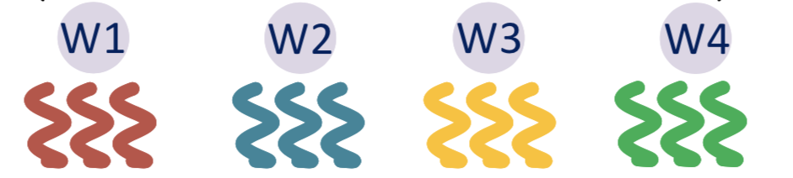
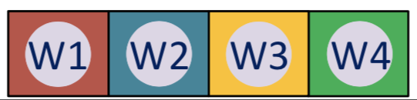
Prior state-of-the-art
Cache-conscious wavefront scheduling (CCWS)
  Limits the degree of multithreading
Warps
Cache Thrashing
L1 cache
Memory Congestion
Prior state-of-the-art
CCWS

Slide 13
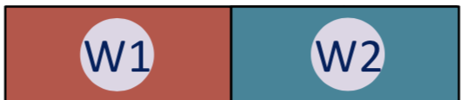
Prior state-of-the-art
Cache-conscious wavefront scheduling (CCWS)
  Limits the degree of multithreading
☓
Warps
Reduces cache thrashing
Cache Thrashing
L1 cache
Memory Congestion
Relieves congestion
Shortcomings
Couples warps with cache performance
Underutilization of shared memory resources
Dynamic policy has significant performance and cost overheads
Static policy burdens the user with the task of profiling every workload
Prior state-of-the-art
CCWS

Slide 14
Prior state-of-the-art
Priority-based cache allocation (PCAL)
Alter parallelism independent of memory system performance
☓
☓
Warps
L1 cache
Prior state-of-the-art
CCWS

Slide 15
Prior state-of-the-art
Priority-based cache allocation (PCAL)
Vital warps (W1, W2, W3)
☓
Warps
CCWS search space
Cache-polluting warps
L1 cache
PCAL search space
Cache-polluting warps
(W1, W2)
Vital warps
Prior state-of-the-art
PCAL

Slide 16
Prior state-of-the-art
Priority-based cache allocation (PCAL)
Vital warps (N)
Determine degree of multithreading
Cache-polluting warps (p)
CCWS search space
Subset of vital warps
Ability to allocate and evict the L1 cache
Reduce cache contention
Cache-polluting warps
PCAL search space
Warp-tuple { N, p }
Vital warps
Prior state-of-the-art
PCAL

Slide 17
Limitations of PCAL
Heuristic-based iterative search are slow in hardware
Prone to local optima in presence of multiple performance peaks
These two limitations lead to sub-optimal solutions
Iterative hill climbing
Cache-polluting warps
Local optimum
Vital warps
Prior state-of-the-art
Limitations of PCAL

Slide 18
Goals
How to find the best warp-tuple?
Balance TLP and memory performance
Avoid local optima
Converge expeditiously
Low sampling and hardware overhead
Avoid burdening the user
Cache-polluting warps
Best warp-tuple?
Vital warps
Goals

Slide 19
Proposal
Poise
A technique to dynamically balance TLP and memory system performance
Machine Learning Framework
Hardware Inference Engine
Supervised learning
Runtime prediction
Unseen user application
Feature Set
Runtime Input
Sample Input
Training Dataset
Regression Model
Feature weights
Prediction Stage &
Local Search
Profiled Kernels
Poise Prediction
via compiler
Sample Output
Best warp-tuple
Best warp-tuple
Poise
Poise: A System Overview

Slide 20
Machine Learning Framework
Analytical Model
Black-box techniques provide little insight
Analytical model uses domain knowledge to identify reliable features
Allows us to reason about the effectiveness of different features
Proposed feature vector consists of only seven features
More details about the analytical model in the paper
Poise
Machine Learning Framework
Analytical Model

Slide 21
Machine Learning Framework
Regression Model
We use Negative Binomial regression to perform supervised learning
Inputs are mapped to the output using a log-linear link function
Reasons for selecting Negative Binomial regression:
  Predicts discrete non-negative warp-tuple values
  Lightweight in training time and dataset
  Low computational demand for training and inference
Poise
Machine Learning Framework
Regression Model

Slide 22
Hardware Inference Engine
Computes runtime predictions about good warp-tuples for new workloads
Constitutes a prediction stage and local search
Unseen user application
Feature Set
Runtime Input
Sample Input
Training Dataset
Regression Model
Feature weights
Prediction Stage & Local Search
via compiler
Poise prediction
Sample Output
Best warp-tuple
Best warp-tuple
Poise
Hardware Inference Engine

Slide 23
Hardware Inference Engine
Prediction Stage
Perform predictions at runtime using new features and learned mapping
Unseen user application
Runtime Input
Feature weights
Prediction Stage
via compiler
Predicted Output
Good warp-tuple
Runtime Feature Collection
Performance Counters
Dot product
Weights ● Features
Inference
Inverse log operation
Poise
Hardware Inference Engine
Prediction Stage

Slide 24
Hardware Inference Engine
Local Search
Mitigate statistical errors in prediction with a near-neighborhood search via gradient ascent
Unseen user application
Runtime Input
Feature weights
Prediction Stage
Warp Scheduler
Local Search
via compiler
Predicted Output
Poise Prediction
Good warp-tuple
Best warp-tuple
Local search is less prone to getting trapped at local optima due to proximity to performance peaks
Poise
Hardware Inference Engine
Local Search

Slide 25
Working Summary
PCAL
Poise
Feature collection
Iterative hill climbing
Cache-polluting warps
Cache-polluting warps
Local Search
Feature collection
Local optimum
Prediction
Vital warps
Vital warps
Poise
Working Summary

Slide 26
Warp Scheduler Architecture
GTO warp scheduler
Warp Scheduler Queue
W_{MAX-1}
Latest
…
…
…
…
W₂
W₁
Oldest
W₀
Warp-ID
bits
Poise
Warp Scheduler Architecture

Slide 27
Warp Scheduler Architecture
Warp Scheduler Queue
W_{MAX-1}
1
1
Latest
…
1
1
…
1
1
…
1
1
…
1
1
W₂
1
1
W₁
1
1
Oldest
W₀
1
1
Warp-ID
bits
Vital bit
Pollute bit
Poise
Warp Scheduler Architecture

Slide 28
Warp Scheduler Architecture
Compiler
Warp Scheduler Queue
Feature weights
W_{MAX-1}
W_{MAX-1}
1
1
0
Constant
Memory
Latest
…
…
1
1
0
…
…
1
1
1
…
…
1
1
Hardware Inference Engine
1
N
Vital Warps
…
…
1
1
1
W₂
W₂
1
1
1
W₁
W₁
1
1
1
Vital warps (N)
Cache-polluting warps (p)
W₀
W₀
1
1
Oldest
1
Warp-ID
bits
Vital bit
Pollute bit
Poise
Warp Scheduler Architecture

Slide 29
Warp Scheduler Architecture
Compiler
Warp Scheduler Queue
Feature weights
W_{MAX-1}
W_{MAX-1}
1
1
0
0
Constant
Memory
Latest
…
…
1
1
0
0
…
…
1
1
0
1
…
…
1
1
0
Hardware Inference Engine
1
…
…
1
1
0
1
p
Cache-polluting
warps
W₂
W₂
1
1
1
1
W₁
W₁
1
1
1
1
Vital warps (N)
Cache-polluting warps (p)
W₀
W₀
1
1
1
Oldest
1
Warp-ID
bits
Vital bit
Pollute bit
Poise
Warp Scheduler Architecture

Slide 30
Warp Scheduler Architecture
Compiler
Warp Scheduler Queue
Feature weights
}
W_{MAX-1}
0
0
Do not participate in TLP
Constant
Memory
Latest
…
0
0
}
…
1
0
Hardware Inference Engine
…
1
0
LOAD [a]
L1 Cache
…
1
0
Do not pollute cache
(bypass on read miss)
W₂
1
1
}
W₁
1
1
LOAD [b]
Vital warps (N)
Cache-polluting warps (p)
W₀
1
1
Allocate and replace cache lines
Oldest
Warp-ID
bits
Vital bit
Pollute bit
Poise
Warp Scheduler Architecture

Slide 31
Evaluation
Platform
  Statsmodels – regression analysis
  GPGPU-Sim (v3.2.2) – cycle-accurate simulator
  GPUWattch (McPAT) – energy and area estimation
Benchmark Suites *
  Rodinia
  MapReduce
  Graph Suite
  Polybench
*Training and evaluation are done on disjoint set of benchmarks
Evaluation
Methodology

Slide 32
Evaluation
Baseline GPU configuration
  32 Streaming Multiprocessors (SM)
  16 KB Private L1 Cache
  2.25 MB Shared L2 Cache
  GTO warp scheduler
  48 warps per SM
Evaluation
Methodology

Slide 33
Evaluation
Warp Scheduling Schemes
  GTO
    Baseline greedy-then-oldest warp scheduler
    Maximum warps enabled per SM for multithreading
  SWL
    Static Warp Limiting from the CCWS scheduler
    No runtime overheads in a static policy
  PCAL-SWL
    Dynamic PCAL policy with SWL for initial start
  Static-Best
    Each kernel run at best performing warp-tuple
    Determined by offline profiling of each kernel
Evaluation
Methodology

Slide 34
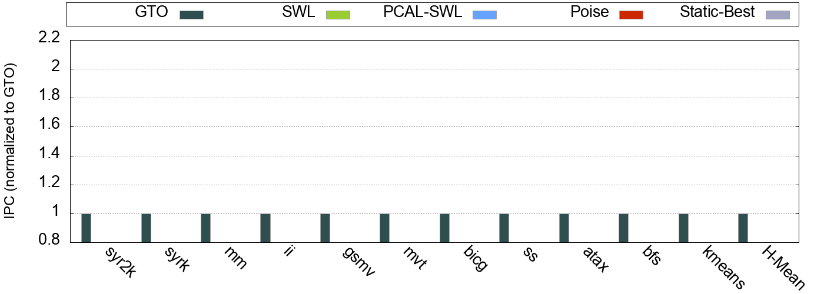
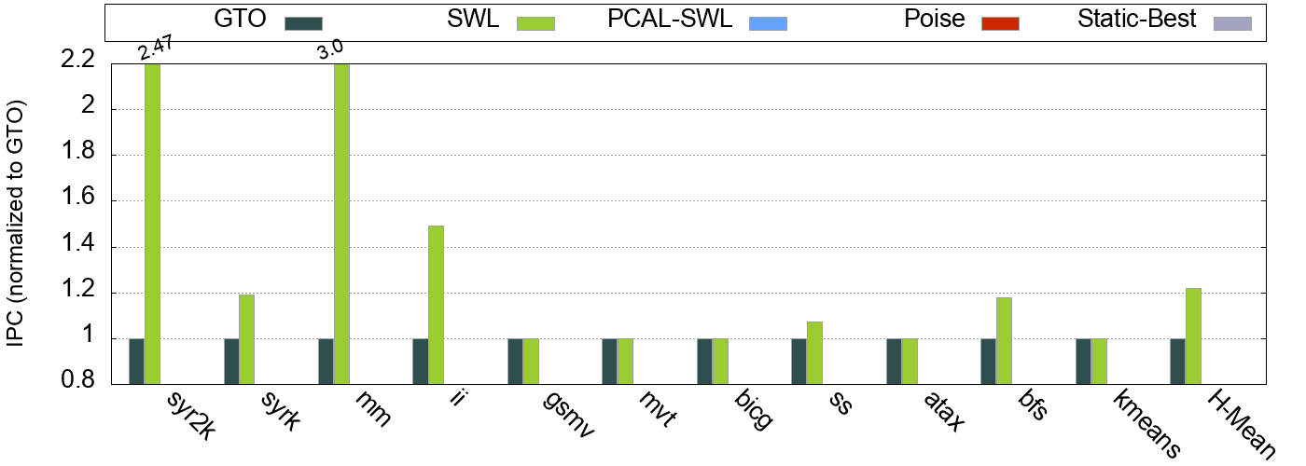
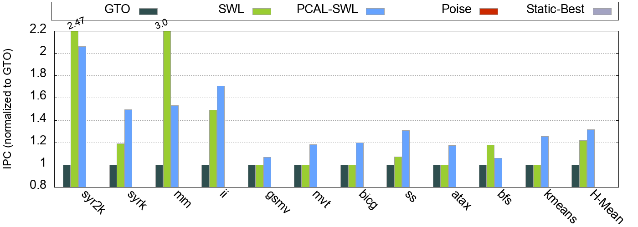
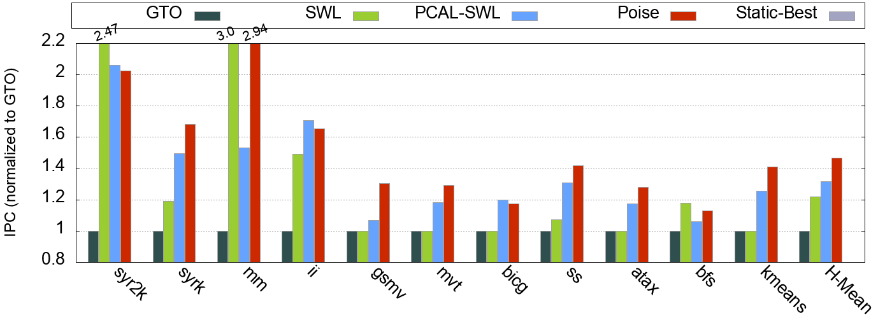
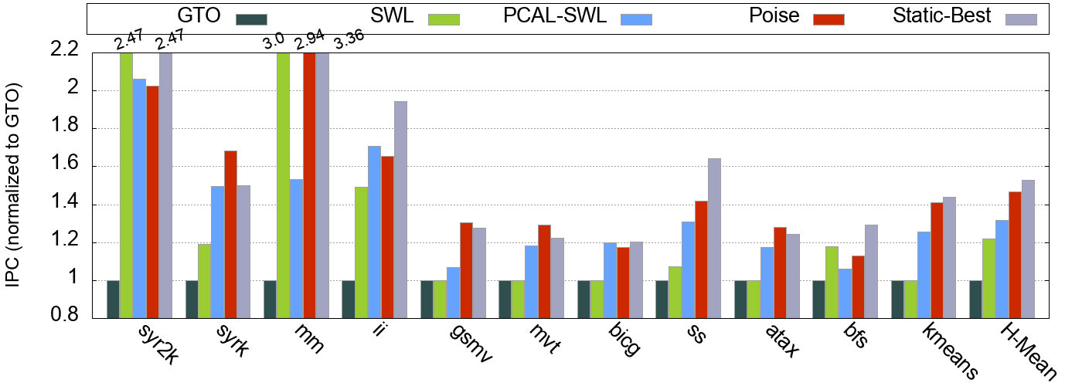
Results
Performance
31.5%
46.6%
52.8%
21.8%
Poise outperforms PCAL-SWL by 15.1% on average
Evaluation
Results

Slide 35
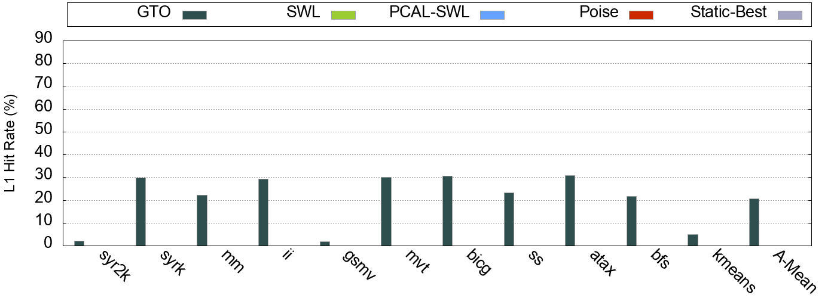
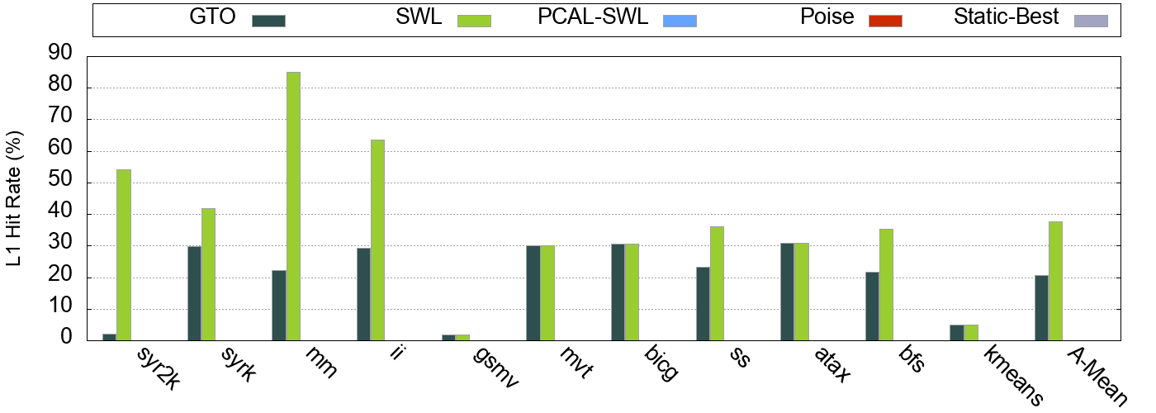
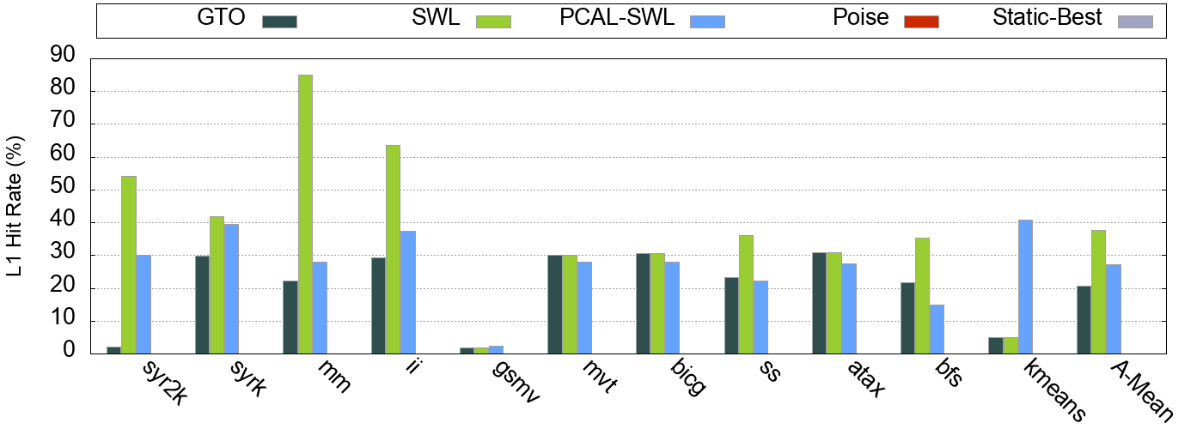
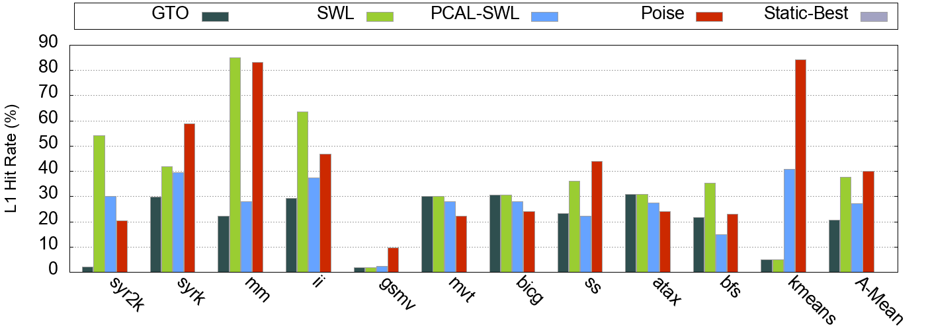
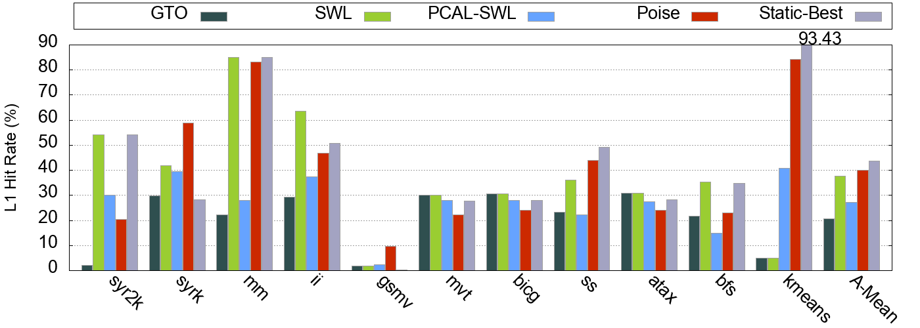
Results
L1 Hit Rate
27.1%
37.7%
40.1%
20.6%
Poise reduces cache thrashing and reduces pressure on memory system
Evaluation
Results

Slide 36
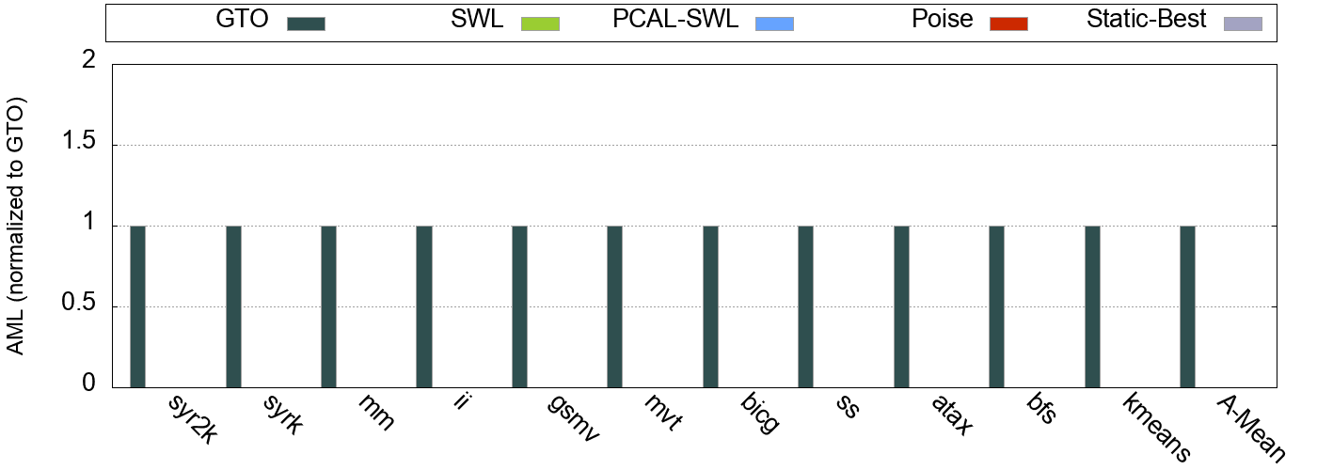
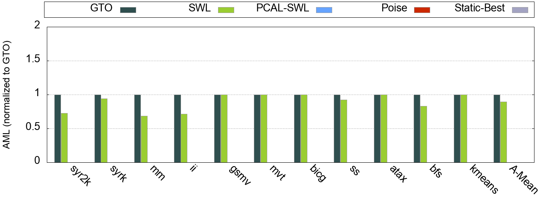
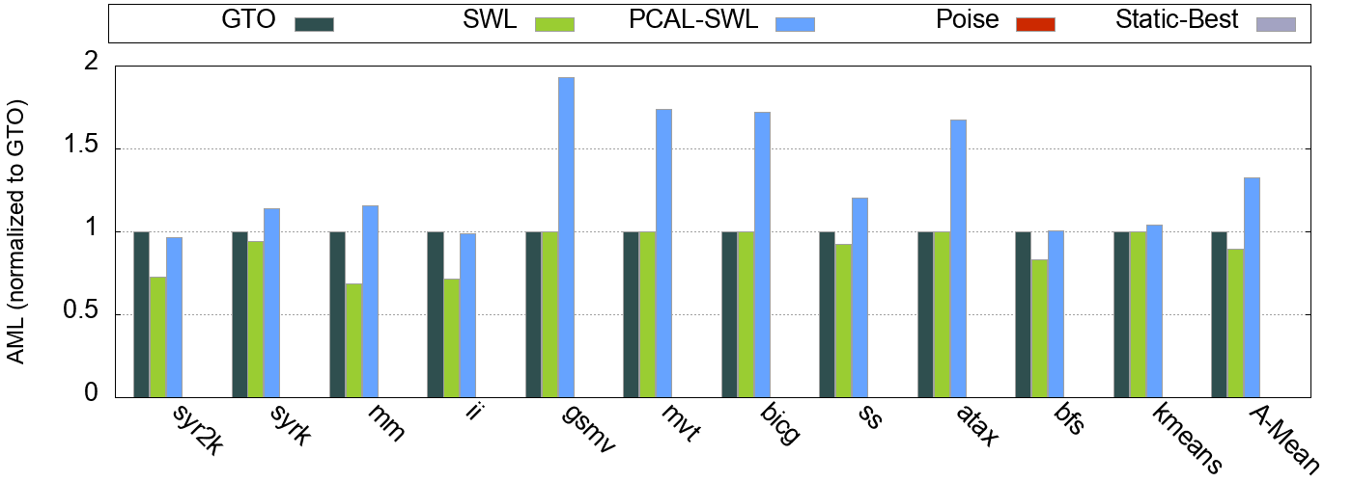
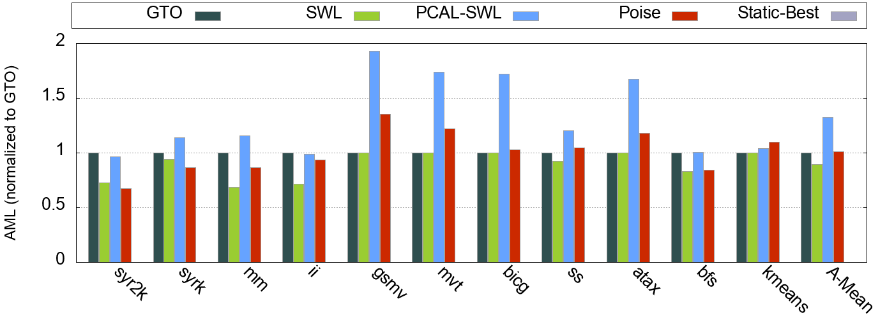
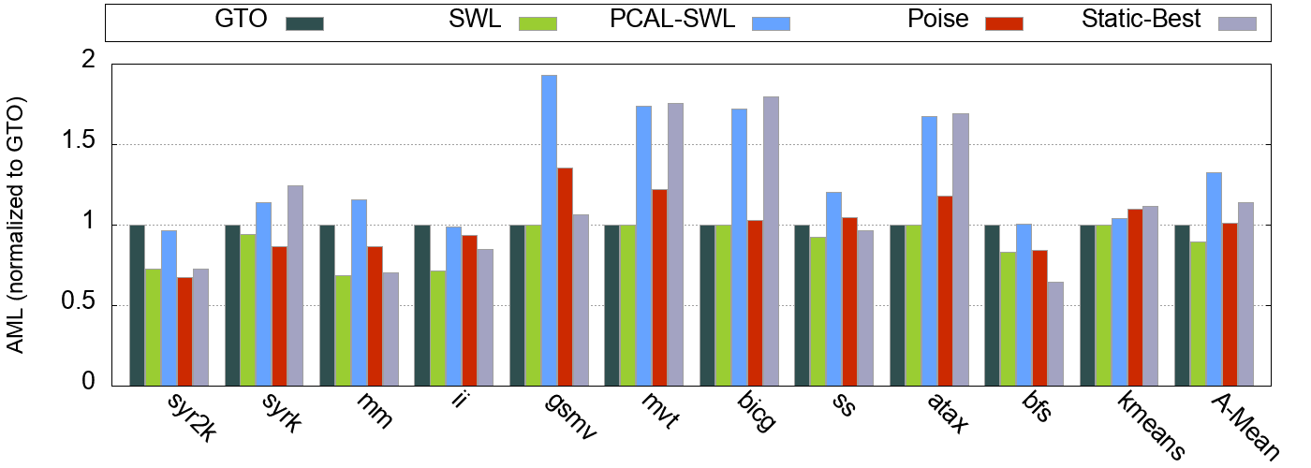
Results
Average Memory Latency
32.4%
1.1%
-10.7%
14.1%
Poise increases the AML by only 1.1% over GTO
Evaluation
Results

Slide 37
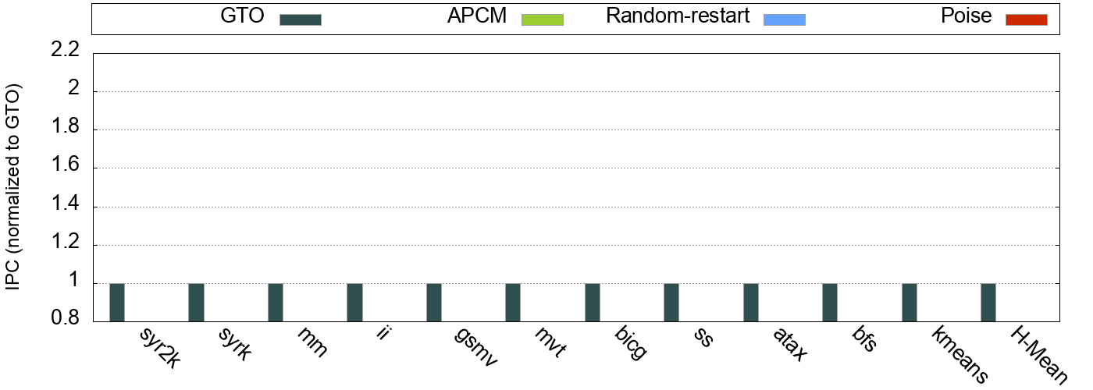
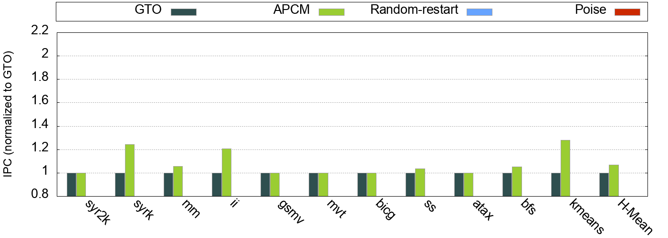
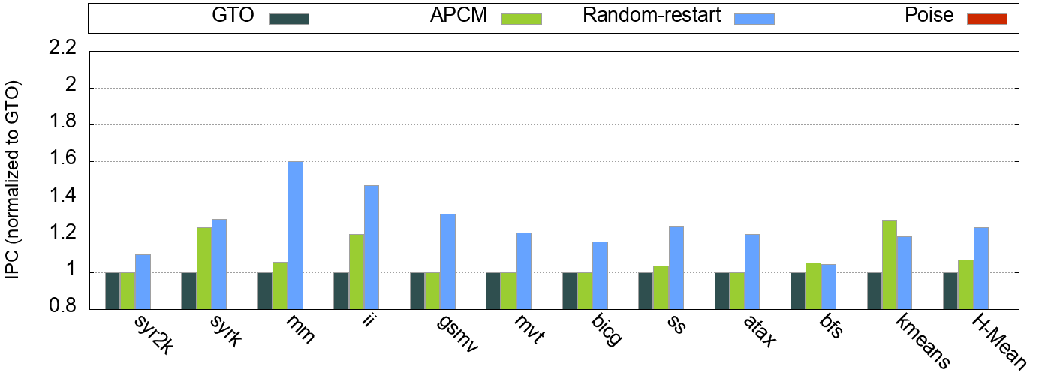
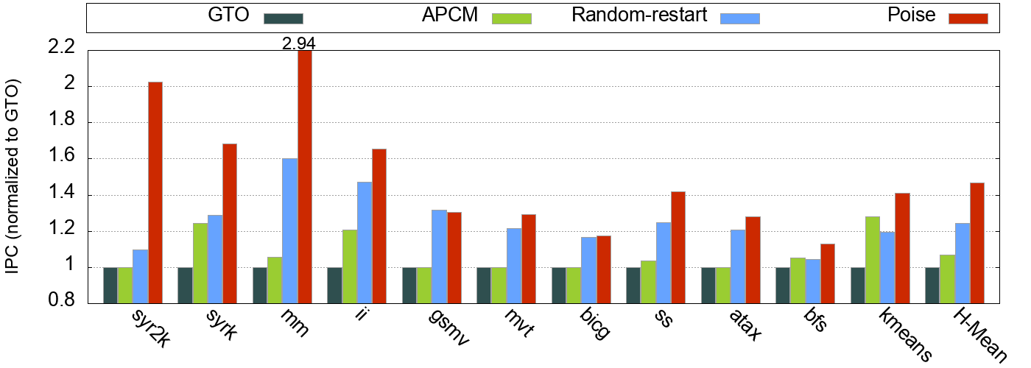
Results
Cache Bypassing & Stochastic Search
24.2%
7.05%
46.6%
Evaluation
Results

Slide 38
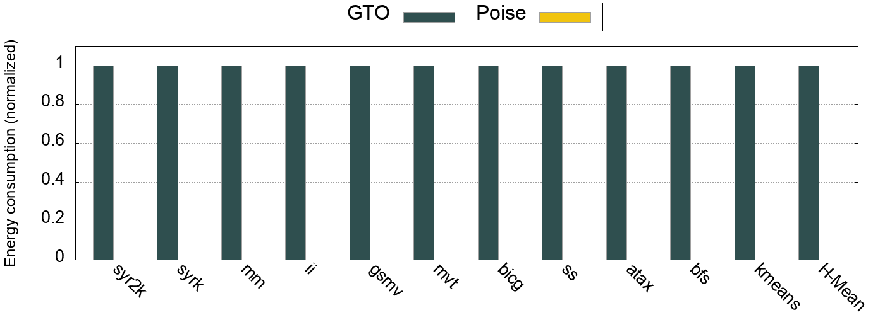
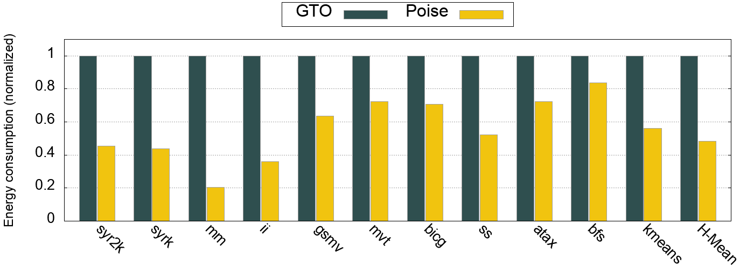
Results
Energy consumption
79%
51.6%
Poise reduces the energy consumption by 51.6% over GTO
Evaluation
Results

Slide 39
Hardware Overhead
Arithmetic Units for link function computation
  Enough spare cycles in existing FP units
  Time-multiplexing existing FP units on SM
  No extra hardware needed
Feature collection
  Seven 32-bit hardware performance counters per SM
Finite State Machine
  Two 3-bit registers per SM
Modified Warp Scheduler
  2-bits per entry in warp scheduler queue
Net storage overhead of 40.75 bytes per SM
Evaluation
Hardware Overhead

Slide 40
Discussion
Why not larger models such as DNNs?
  Bulky nature of complex models
  Generate prohibitively large feature weight matrices with high storage needs
  High computational demands for training and inference
  Black box nature of complex models and feature sets
  Lack of mathematical insights prevents reasoning
Discussion

Slide 41
Discussion
Poise – a machine learning based architecture technique
  Harness domain knowledge to reduce model size and feature vector
  Small, yet effective regression model
  Inference has low computational and storage needs
  Viable architectural mechanism
  Demonstrate an effective use of ML to solve an architectural problem
Conclusion

Slide 42
Conclusion
Problem
  Investigate conflict between TLP and memory system performance
  Traditional techniques to balance are slow and sub-optimal
  Goal is to find good warp-tuples expeditiously in hardware
Proposal
  Poise – a machine learning based architectural technique
  Offline training to learn about good warp scheduling decisions
  Use prior knowledge to make good runtime predictions
Results
  Harmonic mean speedup of 46.6% over baseline GTO scheduler
  Extremely lightweight in terms of hardware overheads
  Demonstrate an effective use of ML to solve an architectural problem
Conclusion

Slide 43
Poise:
Balancing Thread-Level Parallelism and Memory System Performance in GPUs using Machine Learning
Questions?
Saumay Dublish
saumay.dublish@synopsys.com
http://homepages.inf.ed.ac.uk/s1433370/

